Slide 1
STORMWATER INTRUSION INTO KURE BEACH RESIDENCES DUE TO HURRICANE FLORENCE 2018
Denise Malloy Hubbard
with the assistance of
Bob Cooil Jim Dugan Vito Formica
and the Kure Beach Village Homeowner’s Association

Slide 2
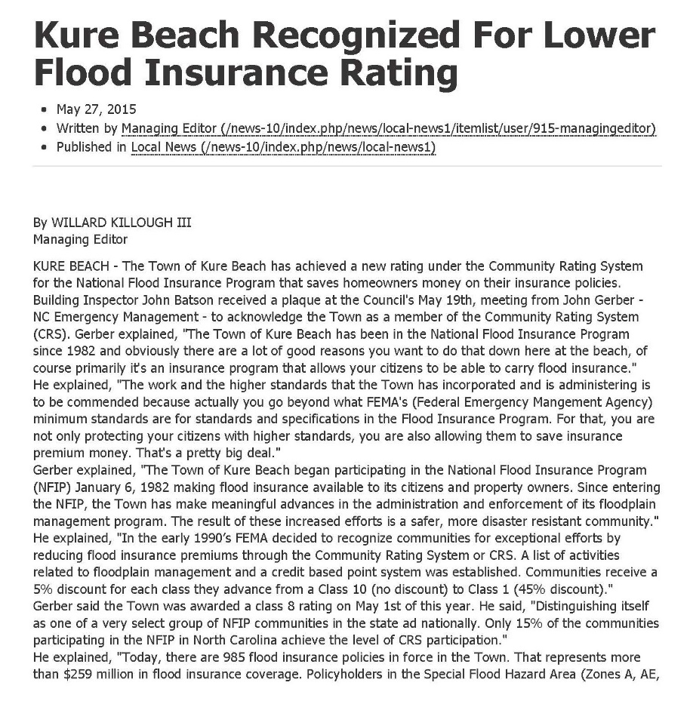
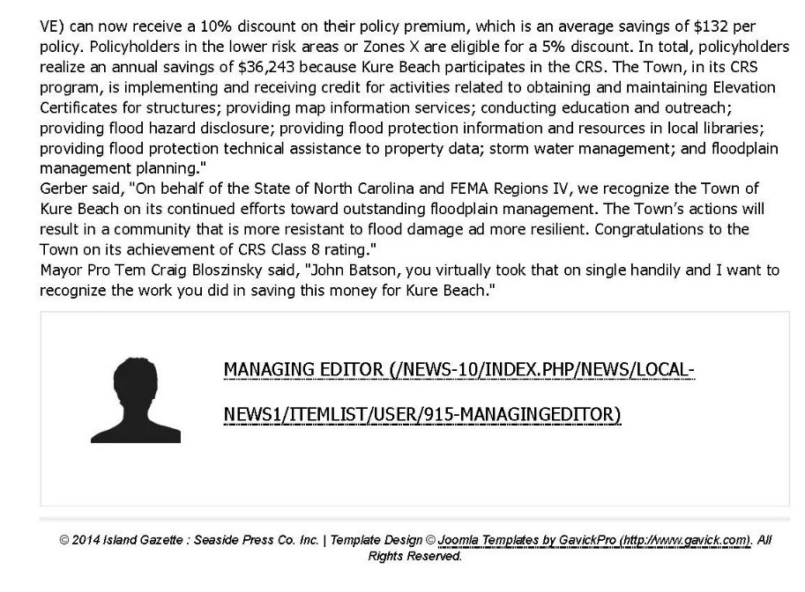
Town of Kure Beach is a recognized
leader in Floodplain management
Notes:
In 2015, the town – led by Building Inspector John Batson – received a rating by the National Flood Insurance Agency that saved our citizens money when purchasing flood insurance. At the time, there were 985 flood insurance policies in force in Kure Beach – representing more than $259 million dollars in flood insurance coverage. Efforts like this – and like the actions of Public Works – every day, but especially during and after storms, make me confident that there is no challenge that this town can’t overcome.

Slide 3
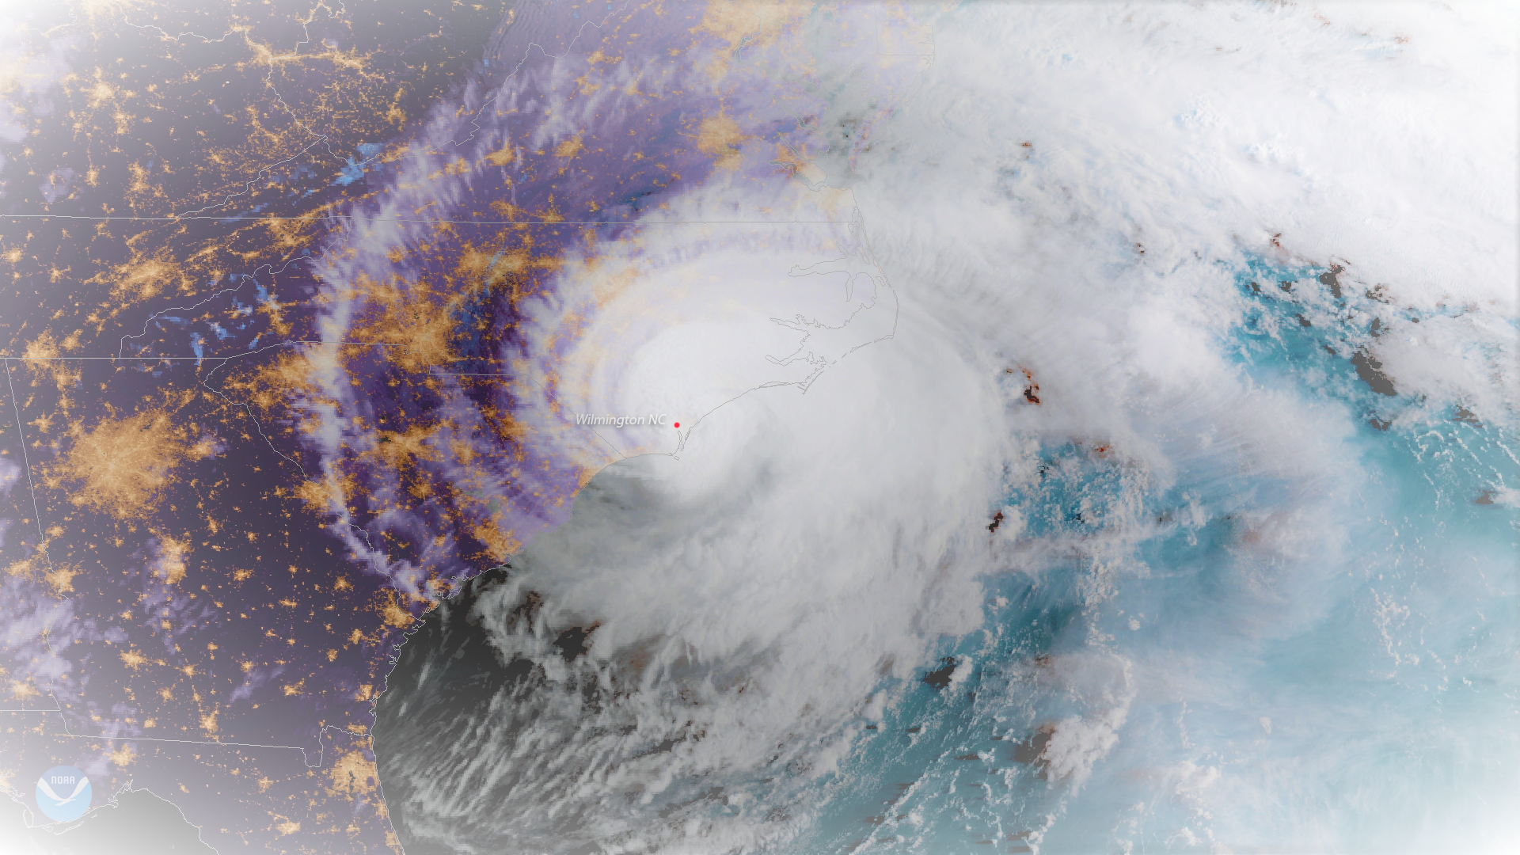
Hurricane Florence makes landfall as a Category 1 Hurricane
Early, on September 14, 2018, Hurricane Florence made landfall just south of Wrightsville Beach, and stayed for several days -- resulting in widespread flooding in Kure and Carolina Beach.

Slide 4
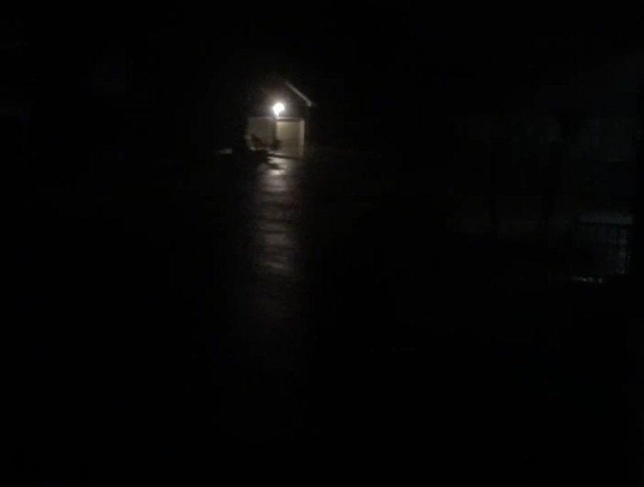
Cutter Court Flooding
Unfortunately, Florence struck in the middle of the night.
Notes:
Worst of the flooding occurred between 2 and 7 am on Sunday, September 16th.

Slide 5
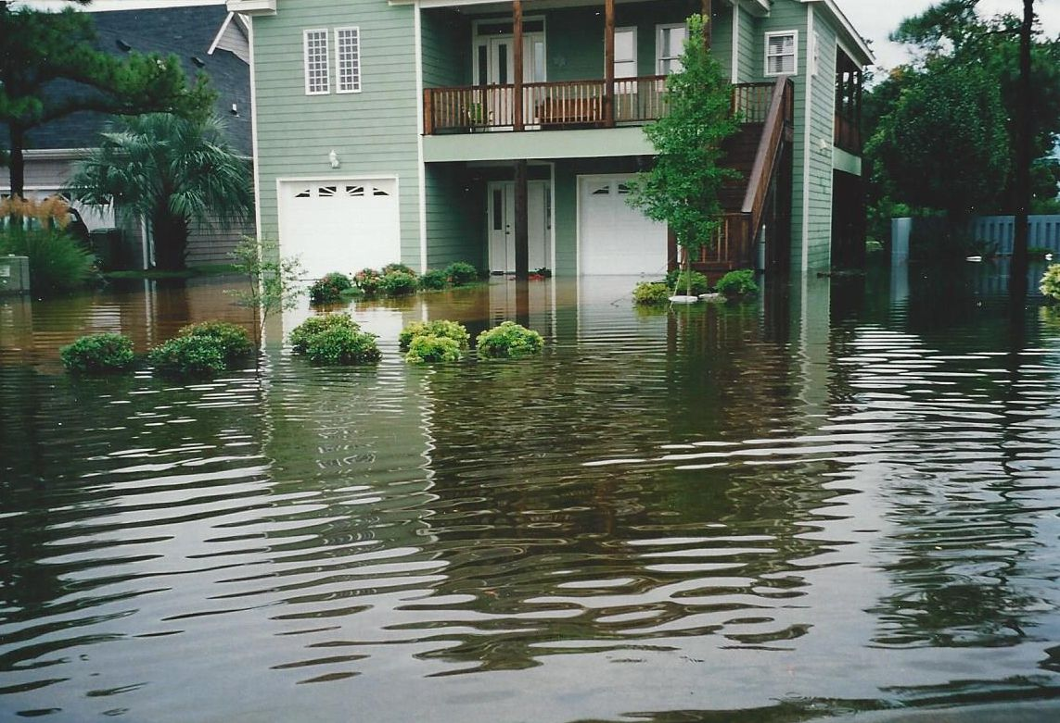
Cutter Court Flooding
2001 flooding shown here. It was less severe than Florence but is representative of the
amount of standing water on Cutter Court. After this flood, larger pipes were installed
and the flooding problem was alleviated …until 2016 to the present.

Slide 6
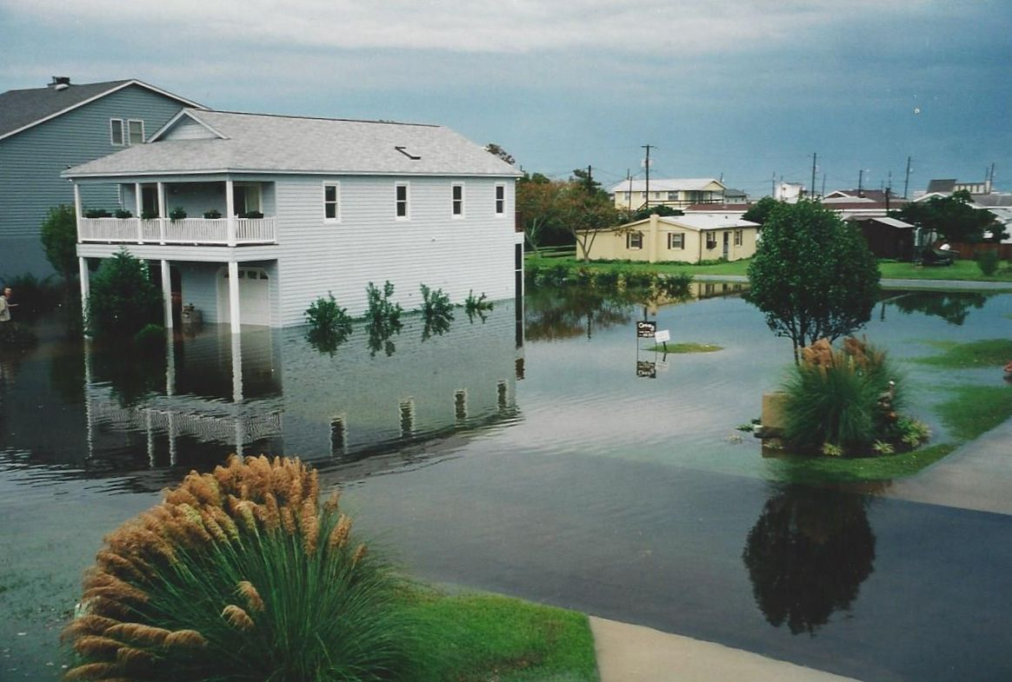
Cutter Court Flooding

Slide 7
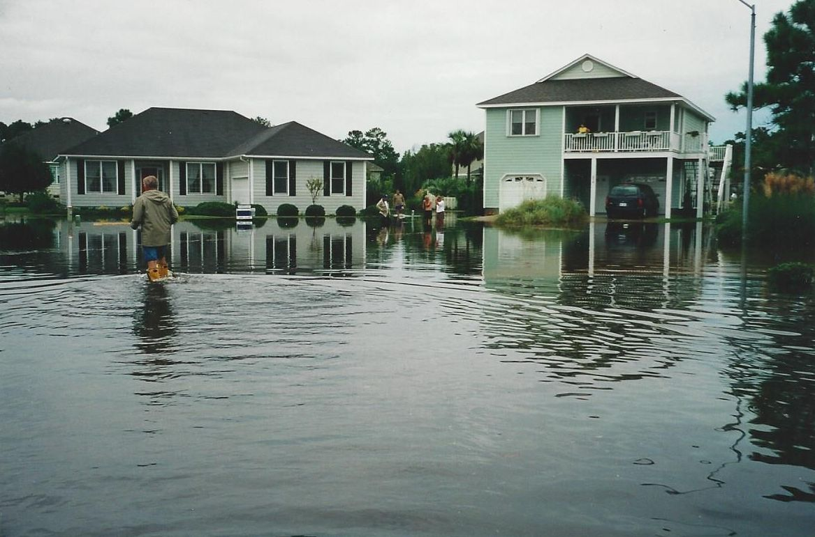
Cutter Court Flooding

Slide 8
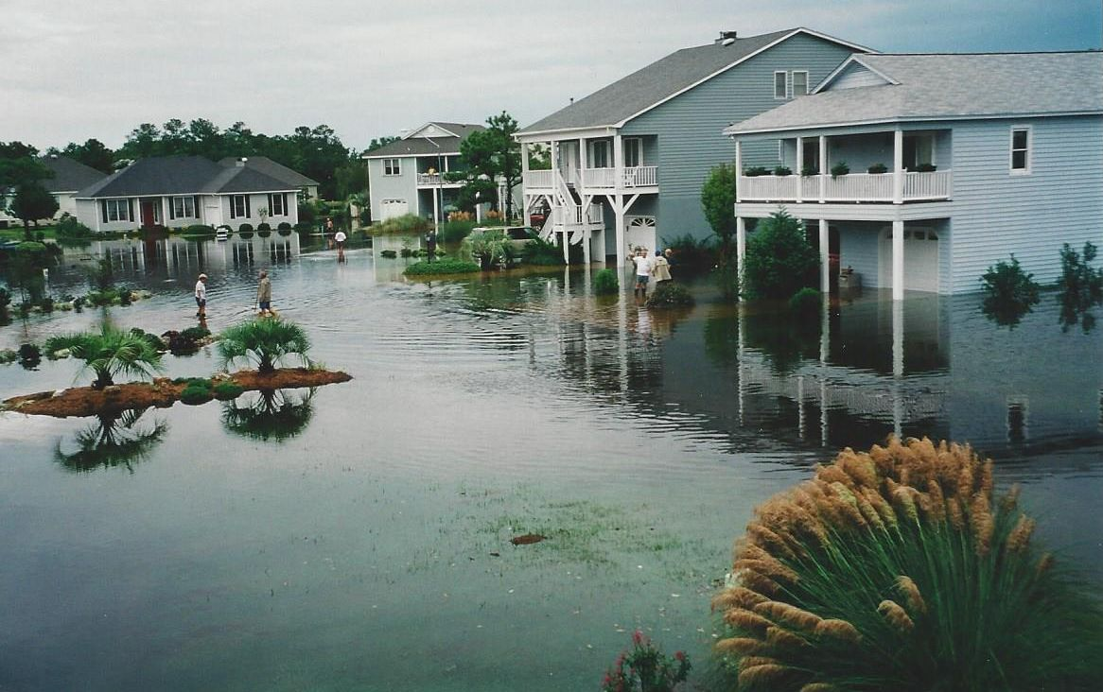
Cutter Court Flooding

Slide 9
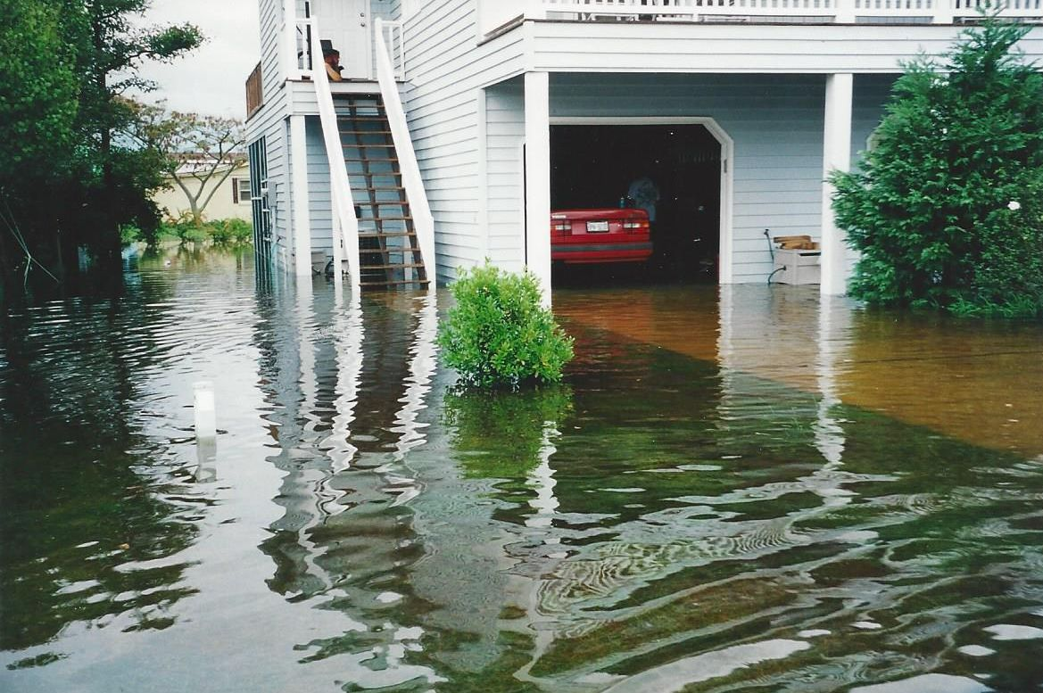
Cutter Court Flooding

Slide 10
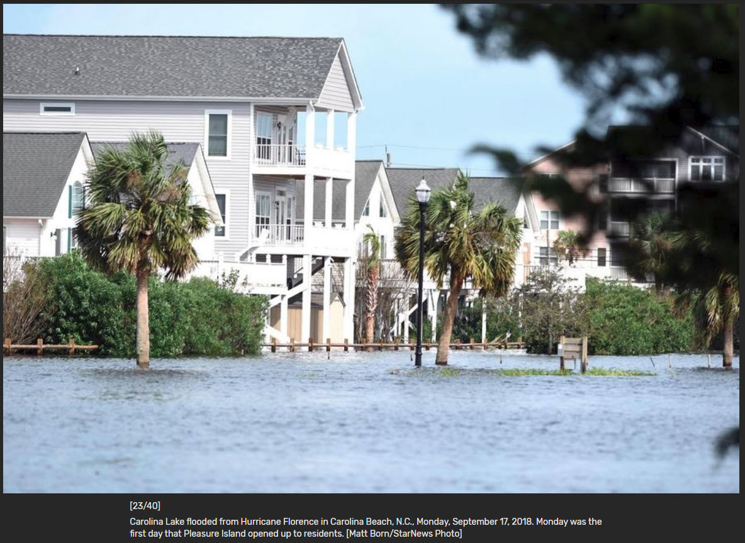
Carolina Beach Lake – 3 days after Hurricane Florence made landfall.

Slide 11
Questionnaire
In an effort to determine the scope of the flooding within Kure Beach Village, former KBV HOA Board of Directors officer Vito Formica created, distributed and collected a simple questionnaire – asking if homeowners had water intrusion due to floodwaters caused by the torrential rains which overwhelmed the storm water systems.

Slide 12
Questionnaire sent by Kure Beach Village re: Florence Flooding
There were more 40 responses from Kure Beach Village residents indicating residential water intrusion due to “the subsequent rain and rising water”.
Even with the positive responses, there is anecdotal evidence that the number of households with water intrusion is under-represented.
Why?
Fear that responding or reporting would result in …
HIGHER INSURANCE RATES!
LOWER RESALE / PROPERTY VALUES!

Slide 13
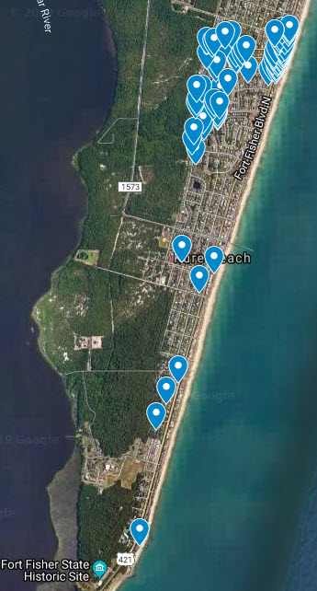
Satellite Google Map
Showing locations of flooded residences.
Including homes identified by
the town,
75 residences were identified
as having water intrusion due
to flooding.
(source: Kure Beach Village survey / Town of Kure Beach Inspections John Batson)

Slide 14
Possible Contributing Factors

Slide 15
DEVELOPMENT and LOSS OF WETLANDS
Development is necessary for the growth of any community.
It is a net positive for the quality of life – a better tax base means more services.
…but we have to recognize it comes with a cost:
The need for increased infrastructure and additional maintenance.
Unintended consequences for existing infrastructure.
Coastal property has always been in high demand and developers naturally want to maximize every square inch. Properties which were once maritime forests and wetlands are now the sites of some of our homes
Notes:
Not saying anything was done improperly or illegally. In fact, I believe my home was once in a wetland area.
The most general state definition of “wetlands” covers “ ‘waters’ as defined by N.C. GEN. STAT. § 143-212(6) (hereinafter G.S.) and are areas that are inundated or saturated by an accumulation of surface or ground water at a frequency and duration sufficient to support, and that under normal circumstances do support, a prevalence of vegetation typically adapted for life in saturated soil conditions. Wetlands generally include swamps, marshes, bogs and similar areas. Wetlands classified as waters of the state are restricted to waters of the United States as defined by 33 CFR 328.3 and 40 CFR 230.3.” 15A NCAC 2B .0202 (1999).

Slide 16
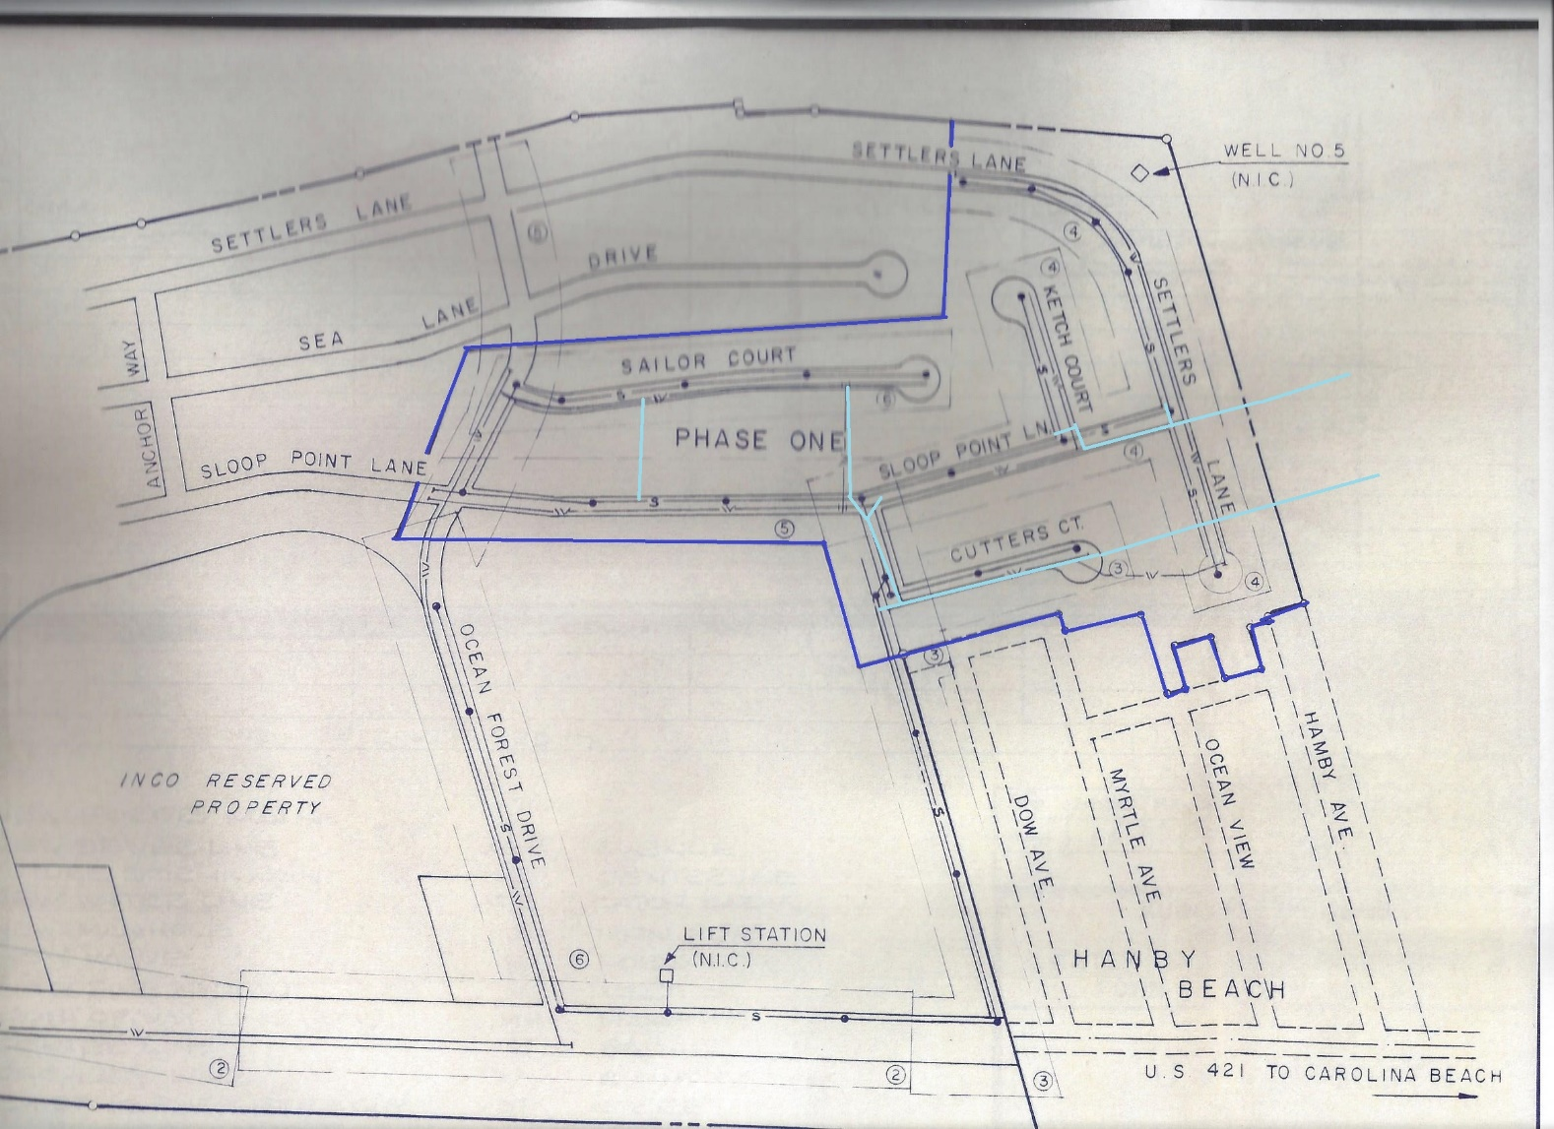
DEVELOPMENT and LOSS OF WETLANDS
Kure Beach Club
now known as
Kure Beach Village
One of the first
developments, it was originally a planned unit development
offering small,
single-story residences.
The Kure Beach Village stormwater system carries runoff to
Henniker’s Ditch.
Notes:
Dark blue line is boundary of original Beach Club development. Light blue lines are stormwater pipes. Note that Gulfstream Drive was referred to as Sea Lane Drive and extended through what, is now, the Keys retention pond.

Slide 17
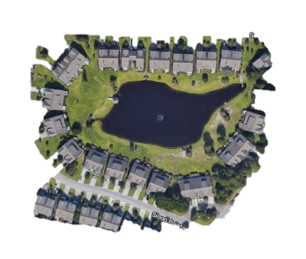
DEVELOPMENT and LOSS OF WETLANDS
As Kure Beach Village,
expands, a townhome
development, The
Keys, are added.
…using a retention
pond to handle
storm water runoff.
The Keys retention
pond may overflow to
the Kure Beach Village
stormwater system
Note: neighboring
community, Kure
Dunes’ retention pond
overflows to the
Keys.
Notes:
Sea Lane Drive is gone and has been replaced by the Keys. Originally designed as patio homes, now are higher density townhomes.

Slide 18
DEVELOPMENT and LOSS OF WETLANDS
Kure Beach Village, expands further…
…using a retention
pond and storm water piping to Henniker’s Ditch to handle storm water runoff.
Notes:
Kure Beach Village expands.

Slide 19
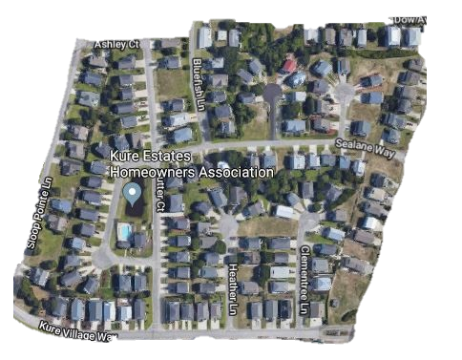
DEVELOPMENT and LOSS OF WETLANDS
Kure Estates came
later…
Originally part of a maritime
forest it required
changes to the natural
elevation.
It uses a retention
pond and swales
to handle storm water
runoff.
Note: the Kure Estates
retention pond
overflows to the
Kure Beach Village
stormwater system
Notes:
The main road to Kure Estates is now named Sea Lane.
A swale is a depression created in the ground that carries rainwater by gravity away from your home and property. It is designed to collect water and gradually allow it to infiltrate the soil below, as opposed to a ditch, which is designed to move water from one location to another.

Slide 20
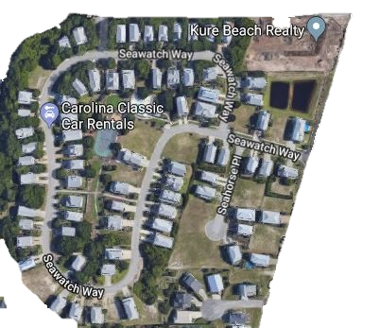
DEVELOPMENT and LOSS OF WETLANDS
SeaWatch was built
on the site of the
LaQue Corrosion
Research site –
essentially in a basin.
It uses a retention
pond to handle stormwater runoff.
Hundreds of truck
loads of dirt were
necessary to achieve
it’s current elevation.

Slide 21
DEVELOPMENT and LOSS OF WETLANDS
Additional developments north of K Ave. include:
Kure Dunes - controls stormwater using a retention pond that overflows
to the Keys retention pond. (Which overflows to the Kure Beach Village system.)
Beachwalk – controls stormwater using two (joined) retention ponds that originally
overflowed to a planned retention pond in Kure Dunes, on Sandman Dr. – which
has been removed. Overflows to a ditch that runs parallel to K Ave. to the Cape Fear River.
Other developments closer to Ft. Fisher Blvd. use swales and ditches to control
stormwater runoff.

Slide 22
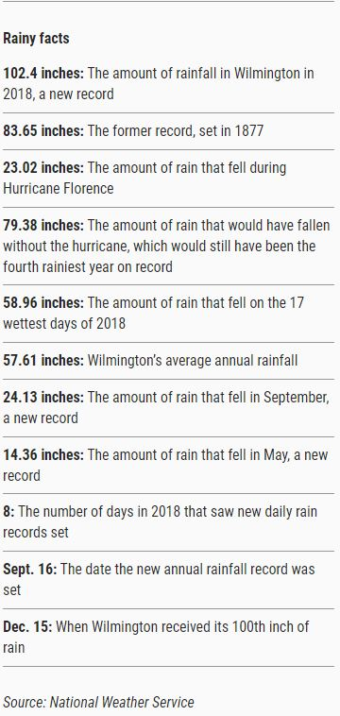
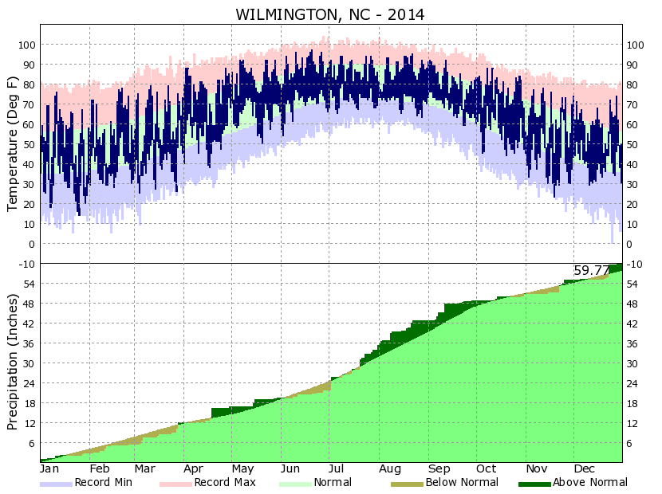
RAIN!
From StarNews article: 2018: What a year ... for rain in Wilmington By Tim Buckland StarNews Staff Posted Jan 2, 2019 at 9:45 AM Updated Jan 2, 2019 at 9:54 AM
Notes:
Wilmington average annual rainfall is 57.61. In 2014 rainfall total = 59.7

Slide 23
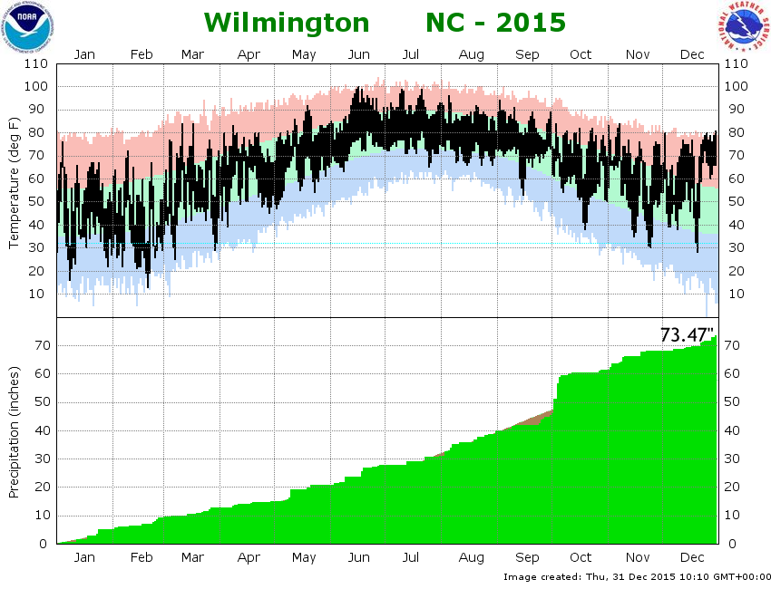
RAIN!
Notes:
2015 rainfall total = 73.47.

Slide 24
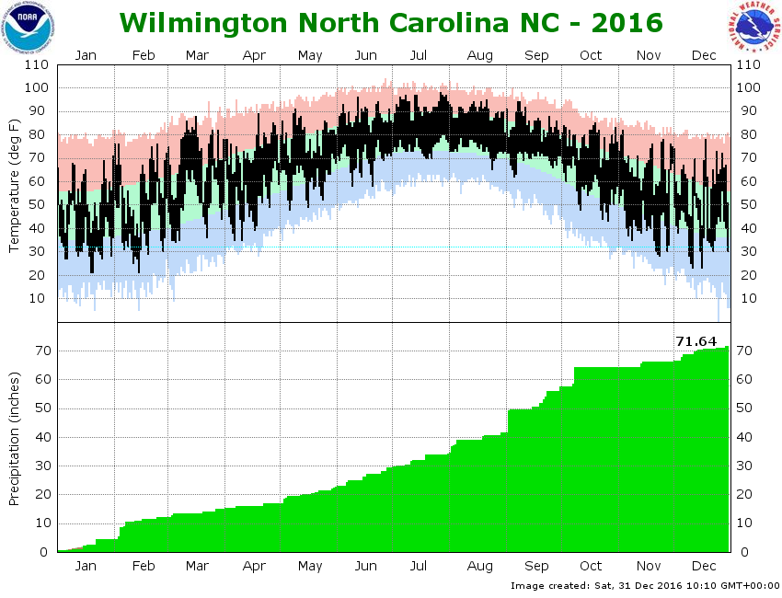
RAIN!
Notes:
2016 rainfall total = 71.64.

Slide 25
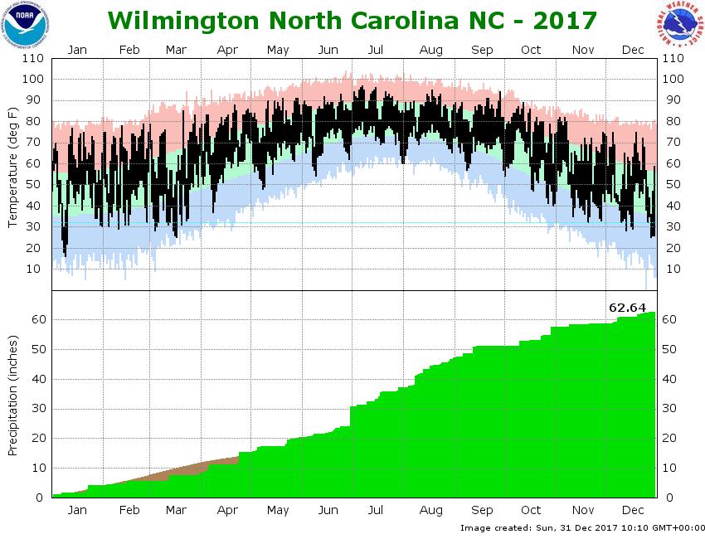
RAIN!
Notes:
2017 rainfall total = 62.64. Still well above 57.61.

Slide 26
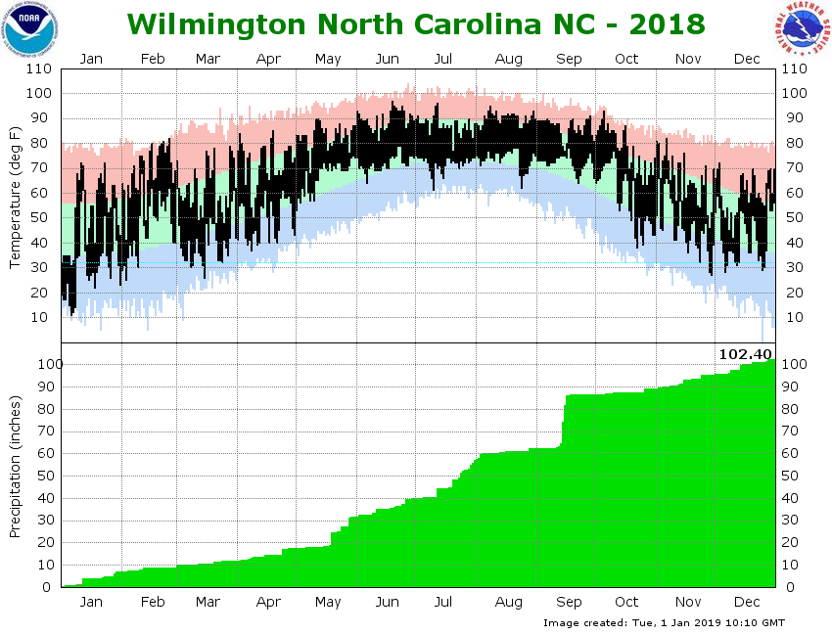
RAIN!
Notes:
2018 broke all records at 102.40.

Slide 27
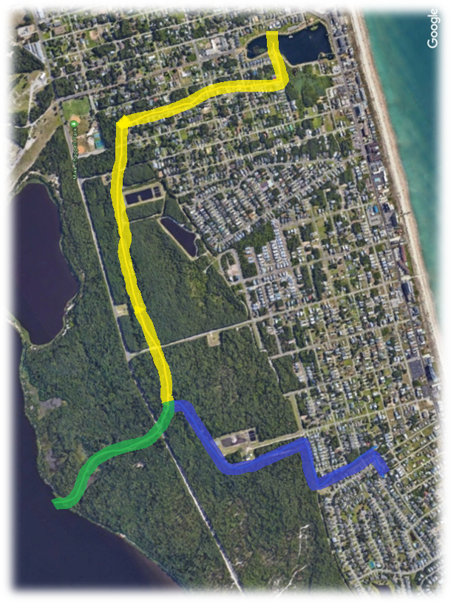
HENNIKER’S DITCH
Henniker’s Ditch is the primary conduit for stormwater runoff to the Cape Fear River for both Kure and Carolina Beach.
Community access to Henniker’s Ditch:
Carolina Beach (yellow)
Kure Beach (blue)
Common outlet to Cape Fear River (green)
Notes:
Carolina Beach has multiple access points not listed on this map.

Slide 28
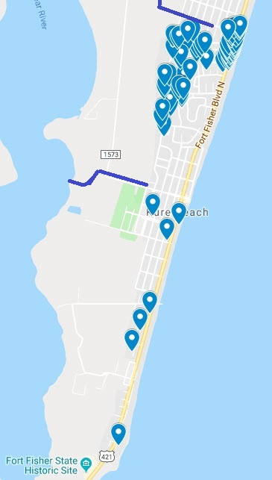
HENNIKER’S DITCH
Flood map showing
the location of the
Kure Beach connection
to Henniker’s Ditch and K Ave. outflows
(in blue)
Notes:
Flooding clustered around KB Village and Henniker’s Ditch access.

Slide 29
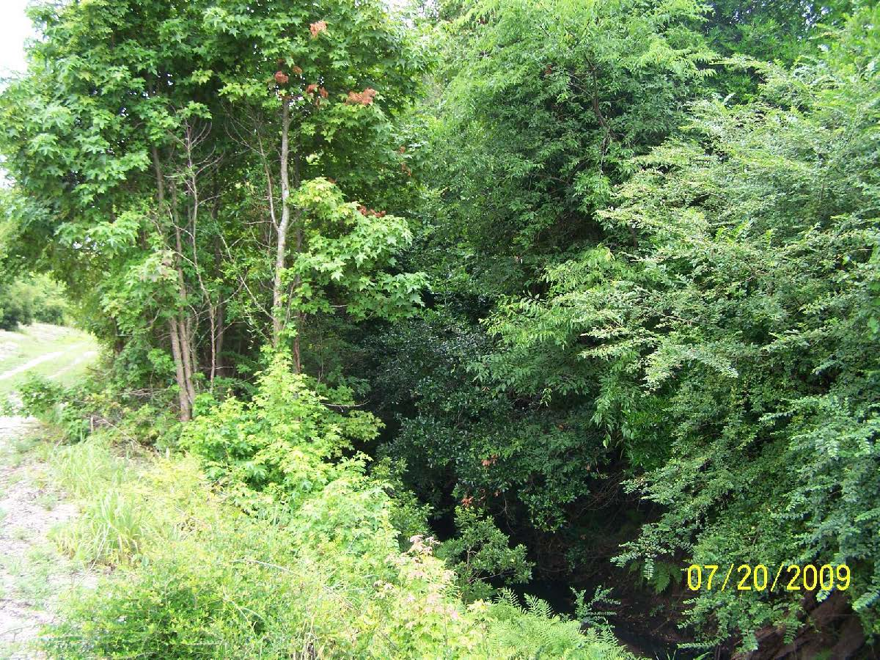
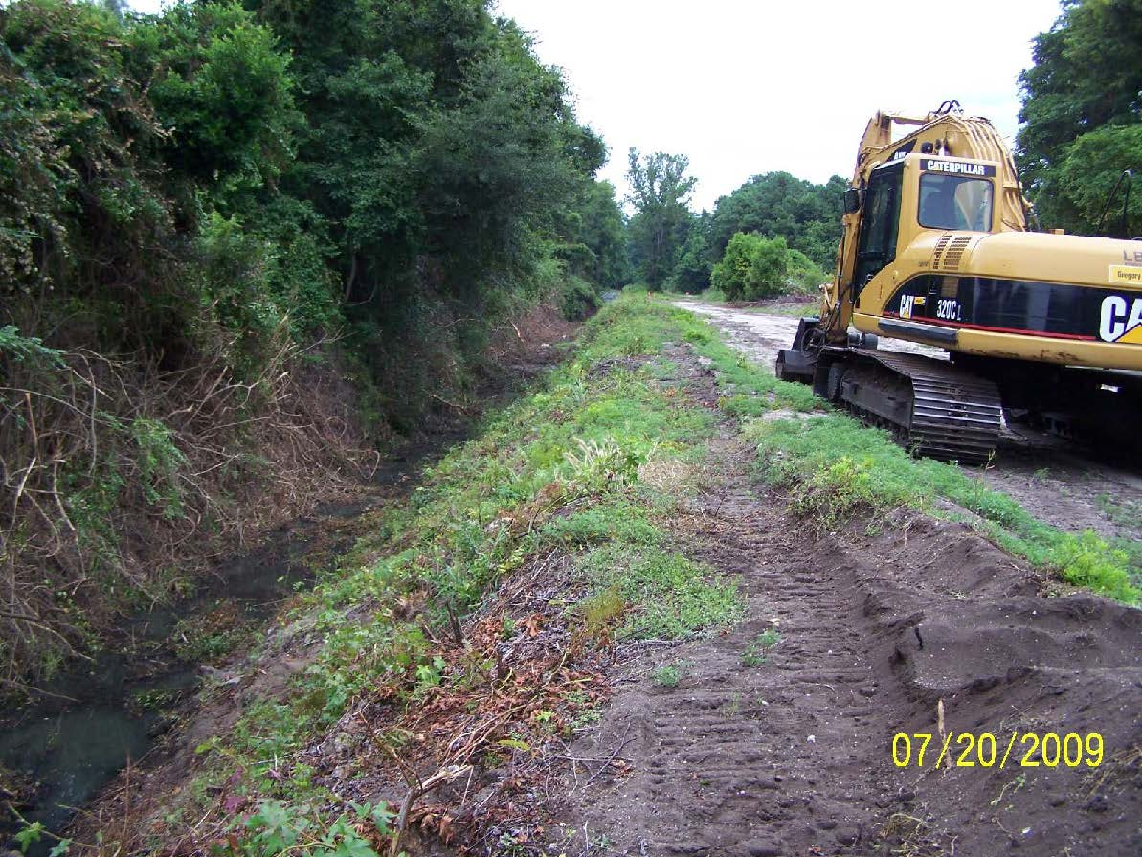
HENNIKER’S DITCH
In 2009 the ditch was overgrown
Before
Requiring a major clean-up.
(source: MOTSU BufferZonePPT_072109website)
After
Notes:
The Kure Beach section of the ditch was improved again in 2016. We don’t have any pictures.

Slide 30
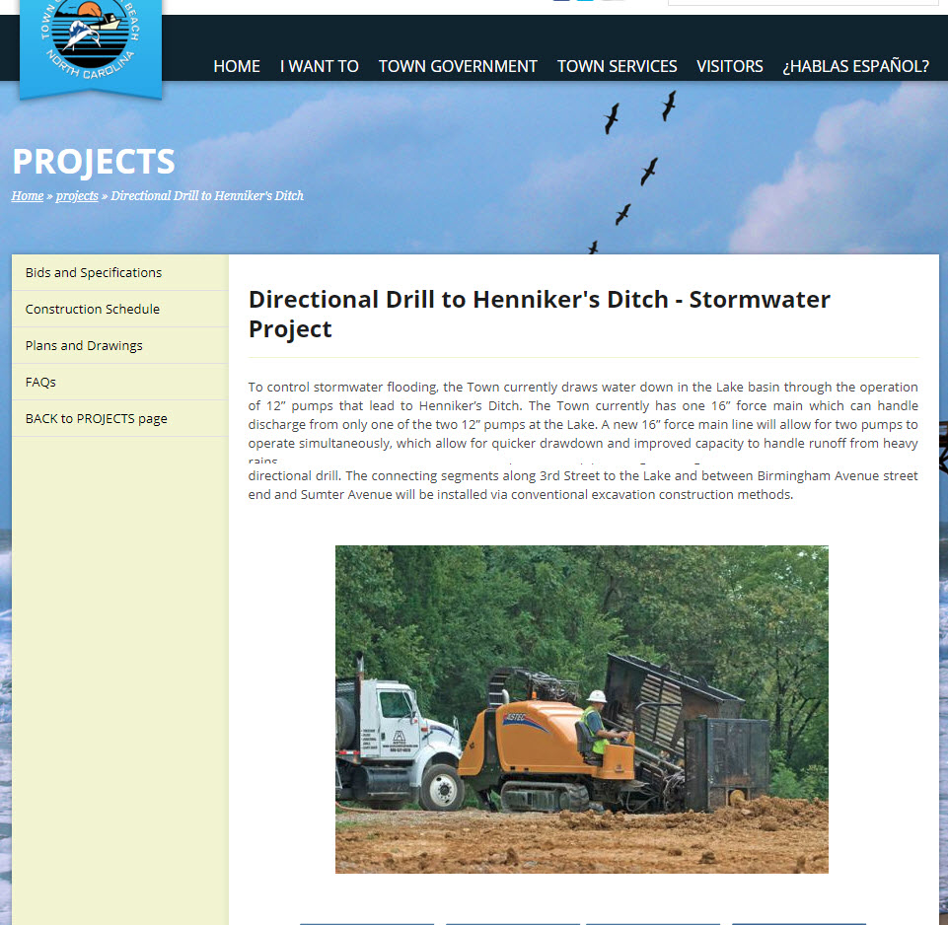
In 2016
Carolina Beach
Increased access to
Henniker’s Ditch
by adding a second
16” force main line
-- doubling the
amount of discharge
to the ditch.
Notes:
Refer to prior photo of Carolina Beach Lake.

Slide 31
Shifting Flood Designation
100 Year Floods happening more frequently.
More powerful storms occurring (Cat 4 & 5)
Florence was a Cat 4 before being downgraded – making landfall as a VERY SLOW MOVING Cat 1.
In Kure Beach, the 100 year floodplain is migrating from the oceanside to the Cape Fear River – and will eventually affect everyone’s insurance rates.

Slide 32
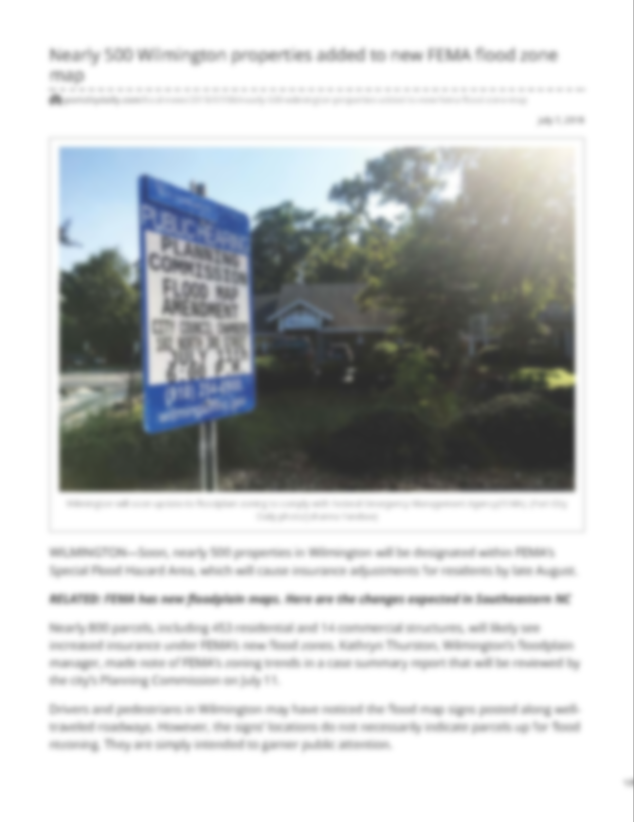
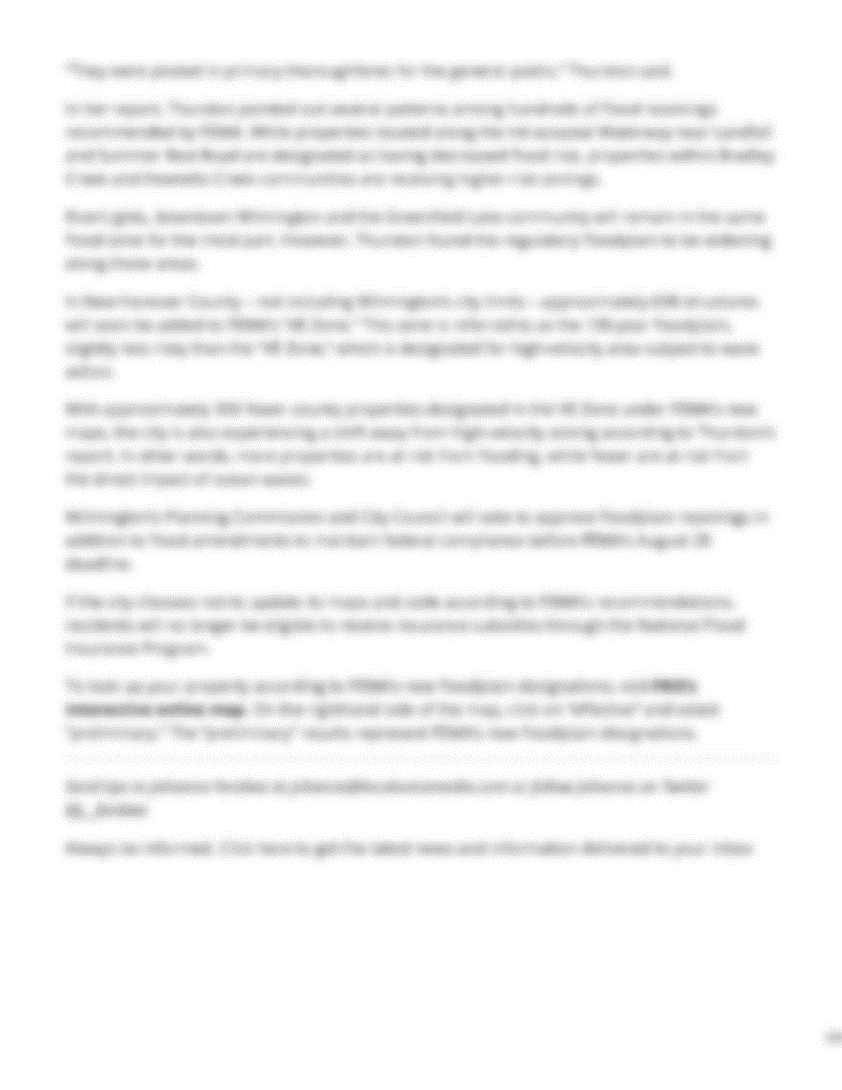
Shifting Flood Designation
Prior to Hurricane Florence
Notes:
Port City Daily July 17, 2018 “Nearly 500 Wilmington properties added to new FEMA flood zone map.

Slide 33
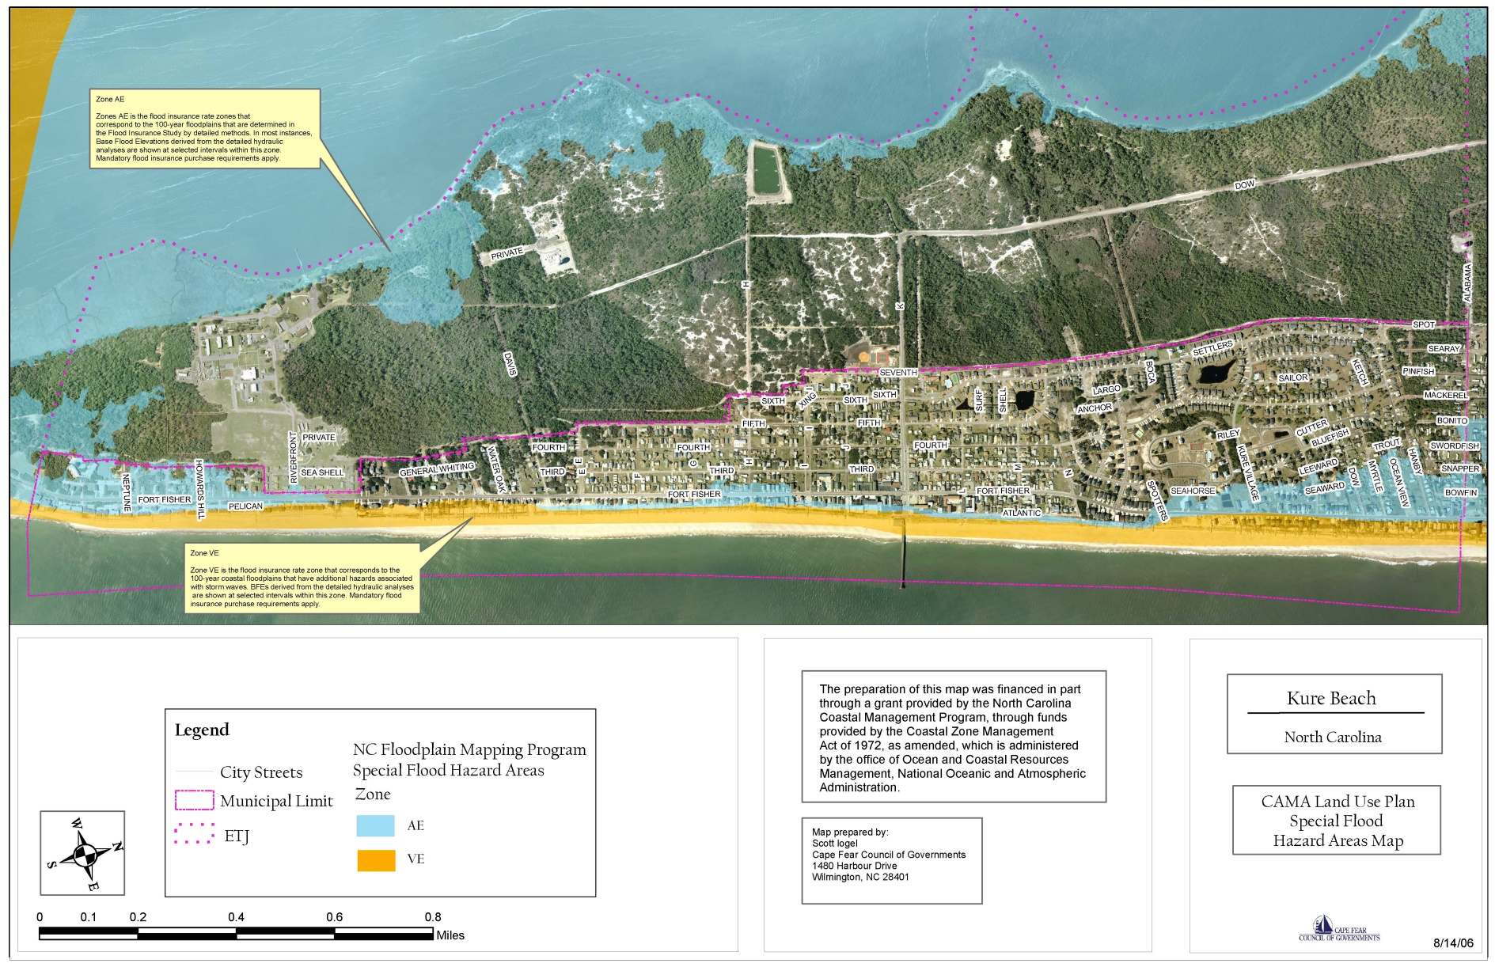
Shifting Flood Designation
Notes:
AE = blue 1 percent per year probability of flooding (100 year flood). VE = yellow 1 percent or greater probability of flooding. Probable flood before a 30-year mortgage is paid off.

Slide 34
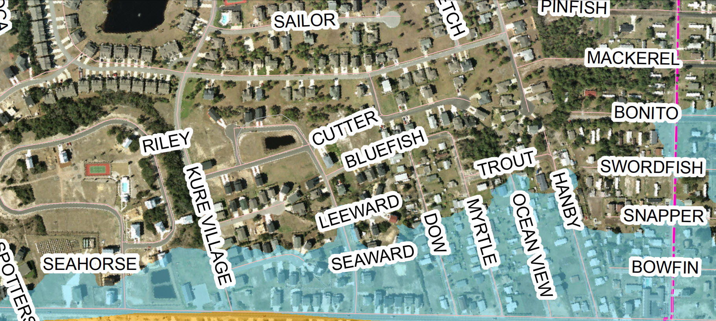
Shifting Flood Designation
2006
Notes:
2006

Slide 35
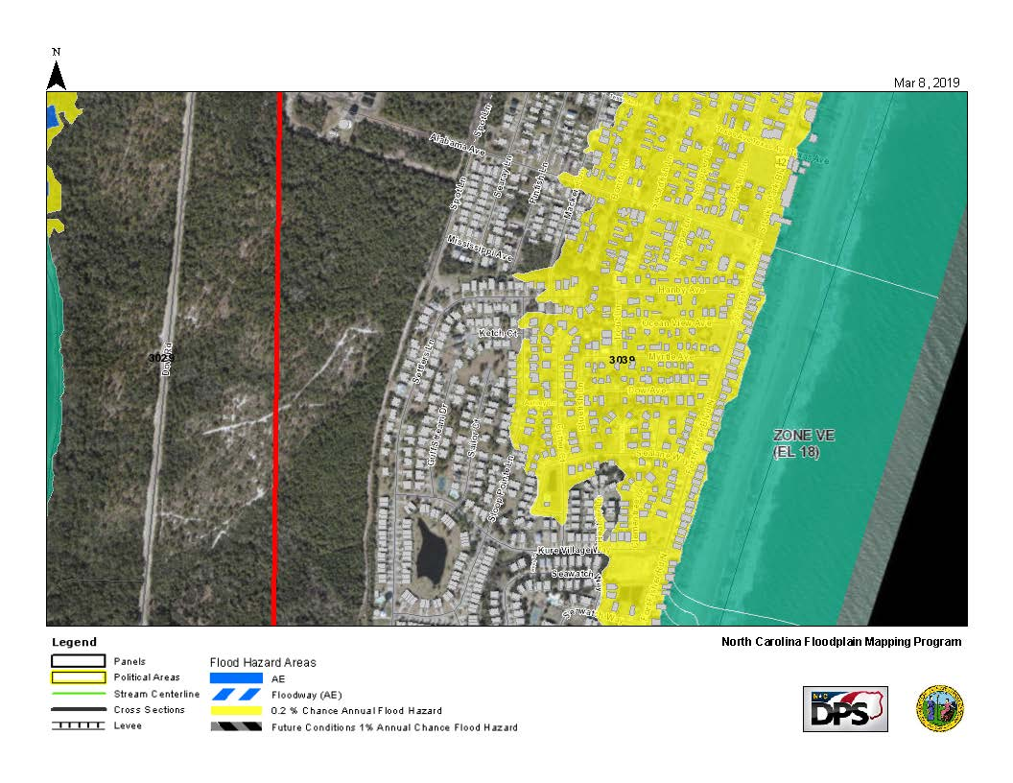
Shifting Flood Designation
Notes:
In 2019, there is now a 2 percent flood hazard. Now includes most of KB Village north of Kure Village Way to Sloop Pointe to Alabama.

Slide 36
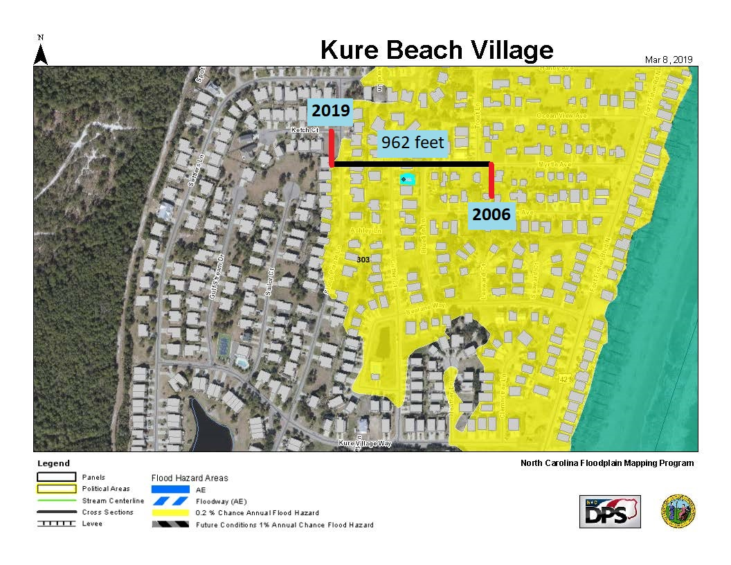
Shifting Flood Designation
Notes:
In thirteen years the flood zone has shifted 962 feet toward the Cape Fear River.

Slide 37
Questions to be addressed
We are experiencing more frequent and more powerful climate events where our current storm water system is overwhelmed.
Does Henniker’s Ditch need to be expanded (widened? more access points? etc.)
We’re competing for “ditch-space” with Carolina Beach. They pump water, ours is gravity-driven. Does our approach need to be more active than passive (pumps? more pumps?)
What Federal/State assistance is available to help us solve our storm water problem?

Slide 38
Why Now?
All of our stormwater systems are inter-related. When one reaches capacity, it overflows to the next.
A failure of one retention pond leads to a cascading failure of others, eventually leading to a failure of the entire system.
This leads to homes being flooded - causing unnecessary short-term and long-term costs to the homeowners. This destroys home values resulting in a shrinking tax base.
Many residents have drainage systems, temporary and permanent, to remove stormwater from their property. Those systems are useless once the stormwater system fails.
We can get the water out of our yards. We can get our neighbor’s water out of our yards. We can’t get the town’s water out of our yard.
Notes:
Short term costs = cost of repairs. Long term costs = loss of property value and damaging affects on resale value.

Slide 39
What are we asking for?
A comprehensive analysis of our current and future stormwater needs.
Implementation of recommendations coming from the analysis.
The use of any and all Federal and State infrastructure funding sources to minimize the financial impact to the citizens of Kure Beach.

Slide 40
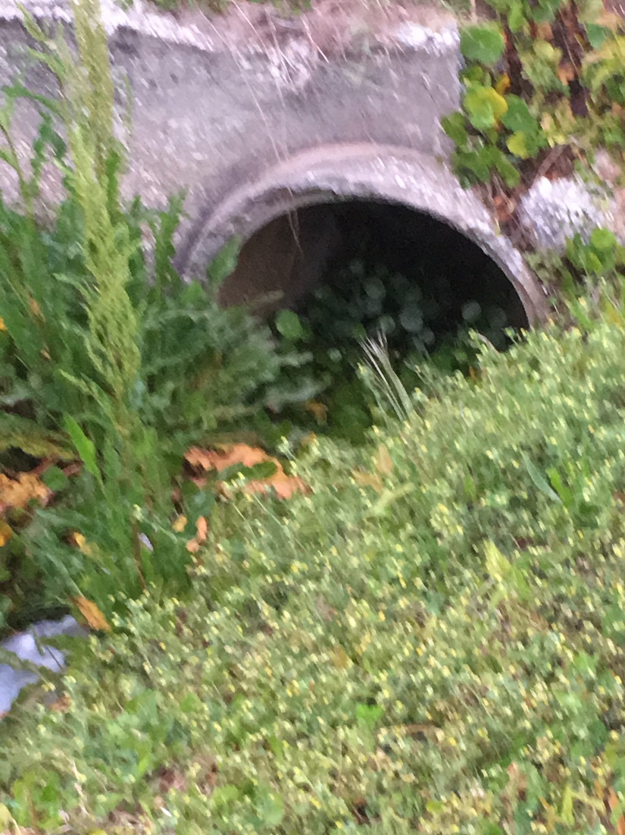
What are we asking for?
Increased maintenance of stormwater systems. swales and ditches.
Increased enforcement of existing stormwater regulations in anticipation of the upcoming storm season.
Encourage HOAs to draw-down retention pond water levels before storm events.
Notes:
Picture from Ft. Fisher and Spotter’s Court.

Slide 41
Thank You!
Notes:
Bob Cooil – for your technical expertise and reminders to only include factual information
Jim Dugan – for your invaluable history in a leadership position with the town and your treasure trove of documents
Vito Formica – your assistance with sending information to members of the village, providing the data base for those that experienced flooding
John Batson – when you went home at night, I know you prayed that you wouldn’t be receiving one of those pesky malloyhubb emails first thing in your morning. Please know I appreciate your efforts to provide me the information I needed to develop this presentation
Nancy Avery – the only individual in the State of North Carolina that was able to locate the diagram of The Beach Club development, now Kure Beach Village
And finally, my Paul…

