Slide 1
Hurricane Preparedness 2018
David W. Heglar, PE
Emergency Response Coordinator

Slide 2
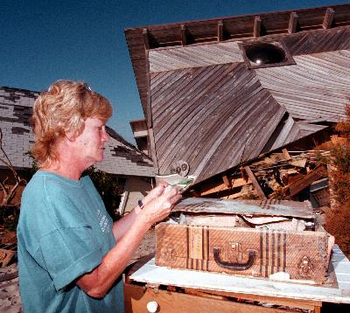
Hurricane Fran

Slide 3
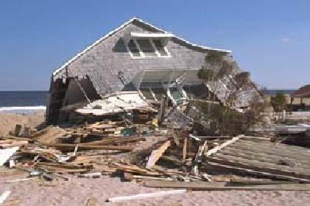
Hurricane Fran

Slide 4
Kure Pier – Hurricane Hazel

Slide 5
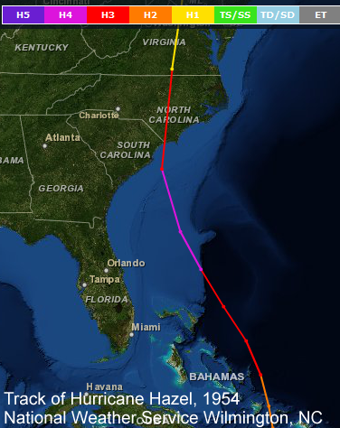
Hazel - 1954
In terms of destruction, it is hard to find a hurricane in the Carolina's history to match Hazel. On October 15, 1954 the center of this legendary hurricane slammed ashore near the NC/SC state line causing a level of devastation virtually unmatched in the local historic record.

Slide 6
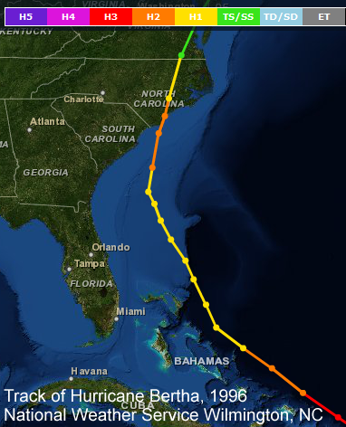
Bertha - 1996
Hurricane Bertha was the first of four strong hurricanes that affected Eastern North Carolina during the mid to late 1990s. Within the span of just four years Hurricanes Bertha, Fran, Bonnie, and Floyd struck the southeastern corner of the state. This period of extreme hurricane activity has a parallel in history to the period 1954-1955 when Hurricanes Hazel, Connie, Diane, and Ione hit the area.

Slide 7
Fran - 1996
Fran killed 22 people and produced over $1.6 billion in insured property damage in the United States, the vast majority of that in North Carolina. New Hanover County officials estimated Fran generated four times as much storm debris as Bertha did. In Kure Beach, Bertha destroyed the fishing pier, then Fran damaged the tackle shop that remained – as well as totally destroying over 40 homes.

Slide 8
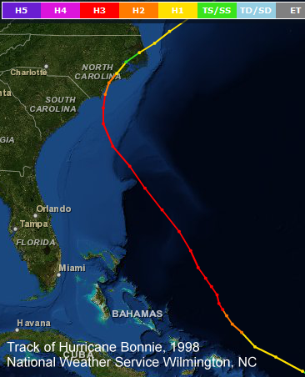
Bonnie - 1998
Winds were measured to 89 mph in Kure Beach. With most southeastern North Carolina beaches remaining west of the landfall point, storm surge values were lower compared to what likely occurred east of the center. Tides along the New Hanover county coast reached 7 to 9 feet. Power was lost to 800,000 people across coastal North Carolina.

Slide 9
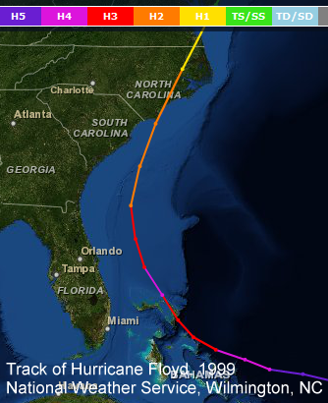
Floyd - 1999
Floyd killed 57 people, 35 in North Carolina alone. Insured losses from Hurricane Floyd totaled $1.32 billion dollars, with perhaps twice that total in uninsured flood-related damage. The USGS calculated Floyd's flooding to have an expected return interval of at least 500 years on some rivers in Eastern North Carolina. Truly one for the record books

Slide 10
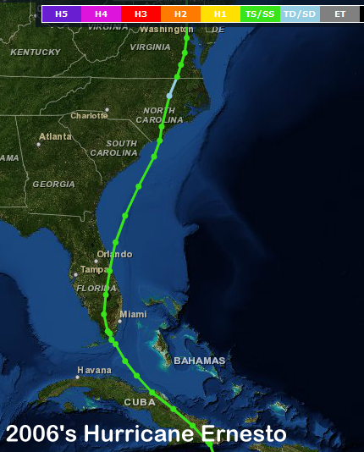

Slide 11
Hurricane 2016 – Public Information Meetings
Who am I?
Town actions in the event of a Hurricane
Individual planning

Slide 12
My qualifications
Lifelong resident of Kure Beach –
family has been in Kure Beach through all Hurricanes since 1948 (Grandfather, Grandmother, Father and Uncle stayed through Hurricane Hazel)
Active KB Fireman since 1996
Participated in response or recovery for Hurricanes Bertha(96), Fran(96), Bonnie(98), Dennis(99), Floyd(99), Isabel (03), Charlie (04), Ophelia(05), Ernesto(06)
CAPTAIN, USNR (ret)
Since 2000 focused on Military Assistance to Civilian Authorities (MACA)
Served as Rapid Response member for Navy Reserve – 2002-2004 – to the 1st and 5th Army responsible for disaster response in the Continental United States
Training plan focused on the National Response Plan and interagency response
Deployed in 2007/2008 to support special operations in the Middle East

Slide 13
My qualifications
Training background
Emergency Management Institute courses
IS-1 Emergency Manager: An Orientation
IS-3 Radiological Emergency Management
IS-100 Incident Command System
IS-200 ICS for Initial Action Incidents
IS-700 National Incident Management Systems
IS-800 National Response Plan
Cape Fear Community College
Hazardous Material Operator – 24 hr course
Various Fire Fighting courses required per NC training plan
US Navy
Firefighting, Hazardous Material, Nuclear Incident Management

Slide 14
Town Actions
The town’s Emergency Response Plan separates actions into three phases:
Preparedness
Response
Recovery
The preparedness phase begins prior to Hurricane Season (June 1st) and continues until the a state of emergency is declared prior to landfall by the Governor, County Commissioners or Kure Beach Town Council.

Slide 15
Preparedness - Town
Provide public information (ERC, Council)
Letter from the Emergency Response Coordinator to all citizens
Public Hurricane information forums
How to request information
Update the Town website with this presentation
Training (ERC, Department Heads)
All Department Heads provide training and information on department responsibilities to their personnel
Volunteers are solicited and provided specific training to support the functions that they are assigned within the hurricane plan
National Incident Management System (NIMS) – new federal requirement for FEMA online courses to support response by ensuring all Emergency personnel – including volunteers, understand how the Federal Government requires emergency response to occur.

Slide 16
Preparedness - Town
Planning
Each Department has specific designated planning responsibilities
Arrange for vendor support – generators, supplies, etc
ERC presents updated Hurricane plan to Town Council at the May meeting – for approval at the June meeting (Historically the earliest Hurricane to hit Kure Beach was Bertha – July 12, 1996)
Ensure department personnel have family action plans to support department requirements.
Provide updated contact information to the NHC EOC
Participate in NHC Emergency Management planning.
May – EOC software training
June 3 – NHC Hurricane drill at the EOC

Slide 17
Response - Town
Priorities of Response
Life Safety – including Emergency Personnel
Protecting Emergency response (includes access) and public property
Restoration of services – priority is water pressure (Firefighting, re-certification of water systems), sewer (prevent overflow and subsequent health concerns), electrical (with Progress Energy support)
Ensuring private property is protected
Restoration of public access to property

Slide 18
Response - Town
Life Safety
Provide timely decisions on evacuation and communicate to all citizens
Encourage citizens to have a Hurricane plan and to evacuate
During the storm (sustained winds > 75 mph) – emergency personnel will shelter in place at location based on storm severity – this means that for those who stay – YOU ARE ON YOUR OWN.

Slide 19
Response - Town
Protecting Emergency response – public property
Water tower isolated prior to the storm
Public buildings shuttered
Generators operating wells
Isolation of water to 1st row homes Category 3 or greater
Emergency personnel lock-in or relocate to designated areas
Rental equipment staged for restoring emergency access
Agreements for debris removal after storm landfall.

Slide 20
Response - Town
Restoration of services
Public works and fire department will verify water system integrity and return water tower to service. Maintain – return generators to operation on wells – isolate any breaks in system.
Damage Assessment teams will audit town for damage to report to NC and NHC Emergency Management
Ensure sewer system integrity manually pump lift stations as needed.
Fire Department will audit Electrical Distribution System – communicate to Progress Energy to facilitate Electrical restoration

Slide 21
Ensuring Private Property Protected
Evacuation orders based on Hurricane Severity
Curfews enforced following the storm until Damage Assessments completed, Public Safety Issues resolved
Curfews initially enforced by Kure Beach Police Department – for larger storms with significant damage NC National Guard and NC Highway Patrol provide extended support
The town has an excellent record of protecting private property – no confirmed incidents of looting during any event in the past 11 years

Slide 22
Restoration of Public Access
Requires public safety issues resolved/contained and water(firefighting) and sewer (protect public property) service minimally restored
Requires Kure Beach residency or ownership during the recovery phase – contractors are signed in through Building Inspections Department
Access is facilitated by Vehicle Town ID stickers
Recommend you ensure via NHC Public Information Office that the Carolina Beach Bridge is open to Residents/Property Owners PRIOR to returning
In FRAN – there was very long lines at the bridge
General access restored when all town services are returned to full service.

Slide 23
What can (and should) you do?
Before the Storm
During the Storm
After the Storm

Slide 24
Before the Storm
Know the hurricane risks for your area. Find out if your home is subject to storm surge flooding.
Inspect your property for potential problems that may arise during a hurricane. Trim back dead branches from trees, and take note of any objects that may become airborne during high winds.
Consider installing permanent protection for your windows. Hurricane shutters offer excellent protection, but marine plywood panels of ½ inch thickness may be a more feasible form of window protection during a weather emergency. Learn how to install the panels and be sure to mark which panels will go where when needed.
If you own a boat, plan ahead where you will put it in case of a weather emergency.
Ensure your property insurance is up to date and sufficient.
Inventory your property by making a list, taking photographs, or making a video. Store records in a secure, dry place like your safety deposit box.
Create a Family Disaster Plan and make sure family members know what to do. Assemble a Disaster Supply Kit. Plan your evacuation route.
Learn Locations of Emergency Shelters.
Make arrangements for Pets.
Make the commitment now to evacuate when told to do so by local officials.

Slide 25
Your Hurricane Plan
Understand the threat
Get information on how to prepare for a hurricane – New Hanover County website is a good source.
Acknowledge that you live in a Hurricane evacuation area – during the season pay attention to storms – be aware of the threat.
Learn about animal care. Animals are not allowed in shelters.
Find out about disaster plans at your workplace, your children's school or daycare center and other places where your family spends time at. Factor in these issues when planning to prepare your property for the storm.

Slide 26
Your Disaster Plan
Create a Plan
Hold a family meeting and discuss why you need to prepare for disaster. Explain the dangers of a hurricane to your children.
Discuss the levels of hurricane and your response to them.
Create a checklist of actions to prepare your property for a hurricane – remove yard items that may become flying debris in high winds.
Ask an out-of state friend to be your "family contact". After a disaster, it is often easier to call long distance. Other family members should call this person and tell them where they are. Everyone must know your contact's phone number.
Discuss what to do in an evacuation. Plan how to take care of your pets

Slide 27
Your Preparations
Stock emergency supplies and assemble a Disaster Supplies Kit.
Take a class from the American Red Cross on first aid and CPR.
Determine the best evacuation routes and your final destination.
Learn location of all Emergency Shelters that might be opened in the event of a disaster.

Slide 28
What the news means
Hurricane Watch: A hurricane watch is issued when there is a threat of hurricane conditions within 24-36 hours. When a hurricane watch is issued, stay tuned to television or radio for official bulletins of the hurricane's progress. If evacuation has not already been recommended or ordered, consider leaving early to avoid traffic. Remember that weather conditions will deteriorate quickly as the hurricane approaches.
Hurricane Warning: A hurricane warning is issued when hurricane conditions (winds of 74 miles per hour or greater, or dangerously high water and rough seas) are expected in 24 hours or less.

Slide 29
Hurricane Watch
When a Hurricane Watch is Issued for Your Area . . .
Listen to local officials
Check often for official bulletins on radio, TV, or NOAA Weather Radio frequency 162.550 MHz
Fuel Car
Check mobile Home tie-downs
Moor small craft or move to safe shelter
Stock up on canned food
Check supplies of special medicines and drugs
Check radio, flashlight batteries, manual can opener
Secure lawn furniture and other loose material outdoors
Tape, board, or shutter windows to prevent shattering
Wedge sliding glass doors to prevent lifting from their tracks
Turn refrigerator and freezer to coldest settings. Open only when absolutely necessary and close quickly
Review evacuation plan

Slide 30
Hurricane Warning
When a Hurricane Warning is issued for your area . . .
Listen to local officials
Stay tuned to radio, TV, or NOAA Weather Radio for official bulletins
Board up garage and porch doors
Move valuables to upper floors
Bring in pets
Fill clean containers with several days supply of drinking water
Turn up refrigerator to maximum cold and don't open unless necessary
Use phone only for emergencies
Stay indoors on the downwind side of house away from windows
Beware of the eye of the hurricane
Leave mobile homes
Leave areas which might be affected by storm tide or stream flooding
Leave early - in daylight if possible
Shut off water and electricity at main stations
Take small valuables and papers but travel light
Bring your pets inside – winds will begin to pickup rapidly.
Lock up house
Drive carefully to nearest designated shelter using recommended evacuation routes
Avoid elevators

Slide 31
Evacuation Ordered
If officials indicate evacuation is necessary . . .
Leave as soon as possible.
Avoid flooded roads and watch for washed out bridges.
Secure you home by unplugging appliances and turning off electricity and the main water valve.
Tell someone outside of the storm area where you are going.
If time permits, elevate furniture to protect it from flooding.
Bring pre-assembled emergency supplies and warm protective clothing.
Take blankets and sleeping bags to the shelter.
Lock up house and leave.

Slide 32
It’s not just Hurricanes Your Family’s Emergency Plan
Quiz your children every six months so they remember what to do.
Conduct fire and emergency evacuation drills.
Replace stored water every three months and stored food every six months.
Test and recharge your fire extinguishers according to manufacturer's instructions.
Test your smoke detectors monthly and change the batteries at least once a year.

Slide 33
Directions To Shelters
Trask Middle School
From Fort Fisher, Kure Beach, Carolina Beach and the Southern End of the County Highway 421 N to Highway 132 W (College Road) - Trask is on the right side of Highway 132 W (College Road) going North.
Eaton Elementary School
6701 Gordon Road, Wilmington, NC 28405
Dorothy B. Johnson School
From Fort Fisher, Kure Beach, Carolina Beach and the Southern end of the County Highway 421 N turn right on Grace Street turn left on McRae Street.
Noble Middle School
From Fort Fisher, Kure Beach, Carolina Beach and the Southern end of the County Highway 421 N to Highway 132 W(College Road) turn right on Highway 17 N (Market Street) - Noble on the right side of Market Street.
Codington Elementary School
4321 Carolina Beach Road, Wilmington, NC 28412

Slide 34
Personal Supplies
Water
Store one gallon of water per person per day.
Keep at least a three-day supply of water per day (two quarts for drinking, two quarts for each person in your household for food preparation/sanitation)
Remember to plan for your PETS!
Food
Ready-to-eat canned meats, fruits, and vegetables
Canned juices, milk, soup (if powdered, store extra water)
Staples - sugar, salt, pepper
High energy foods - peanut butter, jelly crackers, granola bars, trail mix
Vitamins
Foods for infants, elderly persons or persons on special diets
Comfort/stress foods - cookies, hard candy, sweetened cereals, lollipops, instant coffee, tea bags
Your Pets need food also!

Slide 35
First Aid Supplies
Sterile adhesive bandages in assorted sizes
Assorted sizes of safety pins
Cleansing agent/soap
Latex gloves (2 pairs)
Sunscreen
2-inch sterile gauze pads (4-6)
4-inch sterile gauze pads (4-6)
Triangular bandages (3)
Non-prescription drugs
2-inch sterile roller bandages (3 rolls)
3-inch sterile roller bandages (3 rolls)
Scissors
Tweezers
Needle
Moistened towelettes
Antiseptic
Thermometer
Tongue blades (2)
Tube of petroleum jelly or other lubricant

Slide 36
Medicines
Prescription medicines (7-10 day supply or longer)
Aspirin or non-aspirin pain reliever
Anti-diarrhea medication
Antacid (for stomach upset)
Syrup of Ipecac (use to induce vomiting if advised by the Poison Control Center)
Laxative: Activated charcoal (use if advised by the Poison Control Center)
Heart and high blood pressure medication
Insulin
Prescription drugs
Denture needs
Contact lenses and supplies
Extra eye glasses

Slide 37
Sanitary Supplies
Toilet paper, towelettes
Soap, liquid detergent
Feminine supplies
Personal hygiene items
Plastic garbage bags, ties (for personal sanitation uses)
Plastic bucket with tight lid
Disinfectant
Household chlorine bleach

Slide 38
Important Documents
Keep these records in a waterproof, portable container:
Will, insurance policies, contracts deeds, stocks and bonds
Passports, social security cards, immunization records
Bank account numbers
Credit card account numbers and companies
Inventory of valuable household goods, important telephone numbers
Family records (birth, marriage, death certificates)
Digital pictures of your home – on a flash drive with your insurance papers
Documents to return home:
Car – Kure Beach decal
Proof of ownership or residency
waterbill with your name on it
Deed or loan with your name and address
NC Driver’s license with Kure Beach address

Slide 39
Other tools to consider
Mess kits, or paper cups, plates, and plastic utensils
Emergency preparedness manual
Battery-operated radio and extra batteries
Flashlight and extra batteries
Cash or traveler's checks, change
Non-electric can opener, utility knife
Matches in a waterproof container
Aluminum foil
Paper, pencil
Needles, thread
Medicine dropper
Shut-off wrench, to turn off household gas and water
Whistle
Plastic sheeting
Map of the area (for locating shelters)

Slide 40
Pets
Not allowed in shelters
Food
Water
Medications
Leash
Pet Carrier
Do Not leave your pet behind – include it in your plan!

Slide 41
During the Storm
Stay inside, away from windows, skylights and glass doors.
Store drinking water in clean bathtubs, jugs, bottles and cooking utensils.
Keep a supply of flashlights and extra batteries handy. Avoid open flames, such as candles and kerosene lamps, as a source of light.
If power is lost, turn off major appliances to reduce power "surge" when electricity is restored.
Fill bath tubs with water that will not be used for drinking.
Beware of the "Eye" When the storm center passes directly overhead, there is usually a lull that can last a few minutes to more than half-an-hour. This calm is not a sign that the hurricane is over, but is most likely the center or "eye" of the storm. In fact, the most intense part of a hurricane comes just before and just after the eye has passed through an area. Stay tuned to local radio for information

Slide 42
After the Storm
Avoid loose or dangling power lines and report them immediately to the power company, police or fire department.
Beware of snakes, insects or animals driven to higher ground by flood water.
Enter carefully – damage may not be apparent. Open windows and doors to ventilate and dry home. Check refrigerated foods for spoilage.
Do not drink the water. Eat only foods you are absolutely sure are safe.
Be extremely careful when using Generators.
Be extremely careful when using Chainsaws.
Use 911 for emergencies only. Remember that fire, rescue and police crews will be overwhelmed with the recovery effort.
Do not burn any debris until permission is granted to do so by proper authorities.
Call your Insurance Company to file a claim if your home was damaged.
Ask your Insurance Company for financial help.
Listen to local radio stations for official disaster.
Remember: INTERSECTIONS WITH MALFUNCTIONING STOPLIGHTS MUST BE TREATED AS A FOUR-WAY STOP.
Drive only if absolutely necessary and avoid flooded roads and washed out bridges.

Slide 43
Closing
Hurricanes are a reality of living in Kure Beach – its not if but when.
With the extensive warning that comes from a hurricane – individuals can ensure the safety of themselves and their family
Planning now will ensure that you take proper actions when the next hurricane hits
The town will provide information and will respond to hurricanes – as a citizen you must plan and act on the information

Slide 44
Questions or Comments to make the presentation better

